Slide 1
IST659 Data Admin Concepts and Database Management
week 4
Hernando Hoyos
Physical Design & SQL I
1

Slide 2
Acknowledgements and caveat
These course materials draw liberally, with permission, from the following sources:
IST659 classes taught by Prof. Bei Yu
IST659 classes taught by Prof. Susan Dischiave
IST 659 classes taught by Prof. Yun Huang
Instructor resources provided by our text book ”Modern Database Management”
Caveat (beware): At best, PowerPoint slides are only a pale imitation of the entirety of a class meeting. In IST659 in particular, the lectures will cover topics beyond what appears in these slides. Don’t rely on them as a substitute for attending class.

Slide 3
Physical database design
Translate logical design to technical specification
Last database design stage
Conceptual design (ERD)
Entities, attributes, relationships (1:1, 1:M, M:N)
Logical design (relational data model)
Tables, columns, primary keys, foreign keys
Physical design
Space: data type
Time: Index and sort

Slide 4
Database performance
Database performance is an important factor in physical database design, besides data integrity and other concerns.
How do we compare different physical database design?
Space complexity
How much space does your database need?
Time complexity
How fast can you find all records you are looking for?
Tradeoff between time and space complexity
How to estimate the time and space complexity?

Slide 5
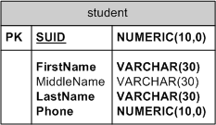
Estimating the data volume
SU Phonebook
One table “Phonebook”

Slide 6
Data types
Choose appropriate data types
Oracle 10g data types
VARCHAR
CHAR
LONG (up to 2GB varchar, text)
Number (a,b)
Integer
Date
Blob (binary large object, multi-media data)
Vendor difference (Number, Numeric)
Phone number (text or number?)
Notes:
Number(a,b) – a means total number of digits; b means the number of digits after/right the decimal point.

Slide 7
SU Phone book: the physical table
SUID | Fname | Mname | Lname | Phone
1234567890 | Abe |  | Green | 3154431156
1357924608 | Brian | E | White | 3154432325
8642135809 | Carrie | Y | Black | 3154439921
…

Slide 8
Estimating the data volume
SU Phonebook
How many rows?
~20,000 students
~1,500 faculty
~400 staff
Total ~22,000 persons
Unit of storage
One byte for one character or number digit

Slide 9
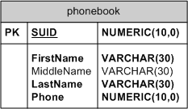
Estimating the data volume
SU Phonebook
How many rows?
~22,000
Unit of storage:
1 byte for a character/digit
How many bytes to store one row?
How many bytes to store all rows?

Slide 10
Estimating the data volume
SU Phonebook
How many rows?
~22,000
Unit of storage:
1 byte for a character/digit
How many bytes to store one row?
SUID: 10; Fname: 30; Mname: 30; Lname: 30; Phone: 10
Total: 110 (max)
Average? 65
How many bytes to store all rows?
110*22,000=2,420,000 (about 2.3MB)
65*22,000=1,430,000 (about 1.4MB)

Slide 11
How to save space?
Coding
A field with limited number of possible values can be translated into a code that requires less space.
E.g. finish (birch, oak, maple) turns into finish (1,2,3)
Need to create look-up table
Compression
Compression algorithms look for patterns in data and codes frequently appearing patterns with fewer bits (e.g. compress bitmap to gif file)

Slide 12
Data volume estimation
Coding
A field with limited number of possible values can be translated into a code that requires less space.
E.g. finish (birch, oak, maple) turns into finish (1,2,3)
Need to create look-up table
Compression
Compression algorithms look for patterns in data and codes frequently appearing patterns with fewer bits (e.g. compress bitmap to gif file)

Slide 13
Time complexity: estimating data access frequencies
Do you need a powerful computer to maintain the SU phonebook?

Slide 14
Estimating data access frequencies
Do you need a powerful computer to maintain the SU phonebook?
Insert: 5000 people come every year
Delete: 5000 people leave every year
Update: (20,000 records)
address change, …
without further information, take half
10,000 changes
Search:
Assume that everyone got looked up a couple times a year, 40,000 queries a year, about 100/day

Slide 15
How to improve data access performance?
If the database is huge
U.S. phonebook database?
Denormalization
Designing physical files
Using and selecting indexes

Slide 16
Denormalization
Normalized relations
solve data maintenance anomalies
Minimize data redundancies (storage space)
May not lead to efficient data processing
Create many tables
Searches involving multiple tables (joining) are time consuming
Denormalization
Merge tables which often co-occur in joined search (e.g. “author” and “book” M:N)

Slide 17
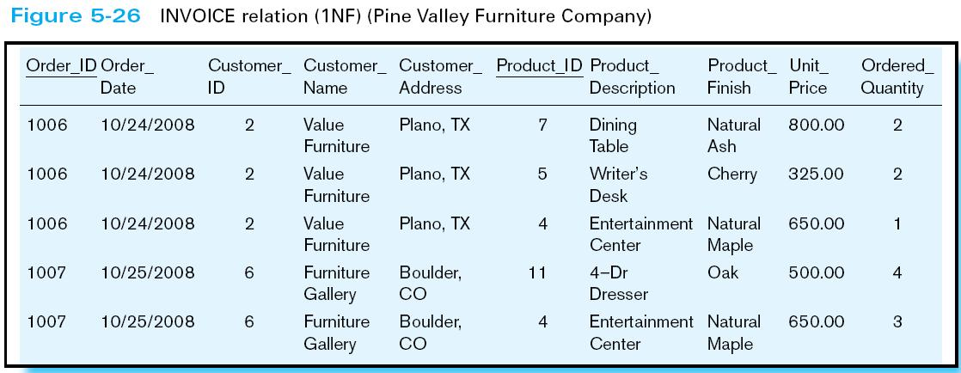

Slide 18
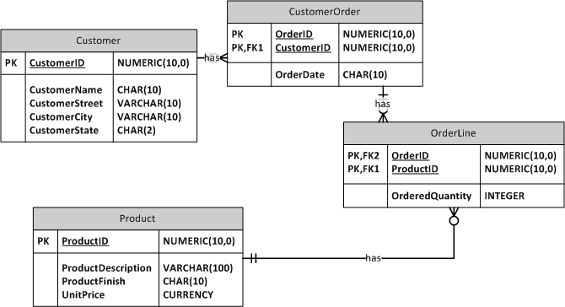

Slide 19
Pros and cons of denormalization
Pros: faster processing
Cons:
Data redundancy
Data inconsistency
Data warehouse
Notes:
Data warehouse usually uses denormalized data model (e.g., a star model: fact table + dimensional tables) for performance.

Slide 20
Design of physical files
After normalization and denormalization, we’ve known the design of records, but records need to be organized into data files to be stored on storage devices.
Performance is also dependent on how records are organized in data files

Slide 21
A File is a sequence of records
Pointers point to the beginning and ending position
Pointers can only go forward to the end and then come back
Records in a file
Record 1
Record 2
Record 3
…
Record N
Record N+1
Record N+2
Record N+3
…
Record 2N
Record 2N+1
Record 2N+2
Record 2N+3
…
Record 3N

Slide 22
A randomly organized file
How long to find a record?
Worst case? Check each of them (N)
Average? Check half of them (N/2)
How long to add a record?
Easy! Add to the end (on the fly)
How long to delete a record?
Find it first!
Record 1
Record 2
Record 3
…
Record N
Record N+1
Record N+2
Record N+3
…
Record 2N
Record 2N+1
Record 2N+2
Record 2N+3
…
Record 3N

Slide 23
A sorted file
Like a library
Records like books
Books are sorted by their call numbers which are assigned by Dewey Decimal Classification rules
Records are sorted by their primary keys
How many records to check before we can find the matching one? How long to find a record if we know the key?

Slide 24
A sorted file
Like a library
Records like books
Books are sorted by their call numbers which are assigned by Dewey Decimal Classification rules
Records are sorted by their primary keys
How many records to check before we can find the matching one? How long to find a record if we know the key?
Binary search (check log₂N times)

Slide 25
What if we have to search by a non-key attribute?
A file can only be sorted by one attribute (or cascading sort)
What if we have to search by student name not student ID?
Cost same amount of time as in random file!
What do we do?
Think about how often we find library books by call number, what if we don’t know the call number, just know the author?
Create index!
Remember the library index card?
Sorted by author names, or titles, or years, or color of the books, whatever is the most often used. What about index for kids?
Each card (entry) points to the actual location of the record in the file

Slide 26
Index
Search key
Index is a look-up table of search key values and the locations of the corresponding records
index_value_1, location_of_record_1
index_value_2, location_of_record_2
index_value_3, location_of_record_3
…
index_value_n, location_of_record_n
e.g
Name, ID
John Smith, 111111

Slide 27
Search the index file instead of the data file
DBMS takes care of the data file organization
We just need to choose the index methods

Slide 28
More indices, the faster?
Don’t forget the cost of maintaining the index
The index is a file by itself!
Every time a record is inserted or deleted, you need to update the data file AND the index also!

Slide 29
Using and selecting indices
Most useful in larger files
What attributes are the best candidates for building index?

Slide 30
Using and selecting indices
Most useful in larger files
What attributes are the best candidates for building index?
The primary key is the default index
The ones that are searched often, hopefully updated rarely
Use an index when there is significant variety in the values of a column
Is gender a good candidate for index?
Be careful of indexing attributes that have null values
Notes:
Usually the index doesn’t store null values

Slide 31
Indexing Rules of Thumb
Use Indexes
Avoid Indexes
The table contains over 100,000 rows
The searchable field (indexed column) has a wide range of values
The searchable field is queried frequently
Queries retrieve less than 2% - 4% of the table’s rows
There are relatively few rows in the table
The column is not used for searching
The majority of the queries that retrieve more than 2% - 4% of the table’s rows
There is high insert or update transaction volatility
CREATE [UNIQUE] [NONCLUSTERED] INDEX index_name ON table_name (column_name [ASC|DESC][,…n])
Notes:
Why the field has a large number of null values?

Slide 33
SQL Server log in
Server name: ist-s-students.syr.edu
Your login and password
Can be retrieved from https://myit.ischool.syr.edu
Change password if you haven’t done so!
Off-campus access
Fail to access the class SQL server remotely is not an acceptable excuse for late submission of your work
Install SU VPN and SQL Server 2012 express with Management Studio http://its.syr.edu/security/remoteaccess/vpn2.cfm http://www.microsoft.com/en-us/sqlserver/editions/2012-editions/express.aspx
Need to run SU VPN every time you log on to our class SQL Server from off-campus

Slide 34
SQL and its purpose
Why SQL?
A common language shared by all DBMS software
variations
Components
DDL: Data Definition Language
DML: Data Manipulation Language
DCL: Data Control Language

Slide 35
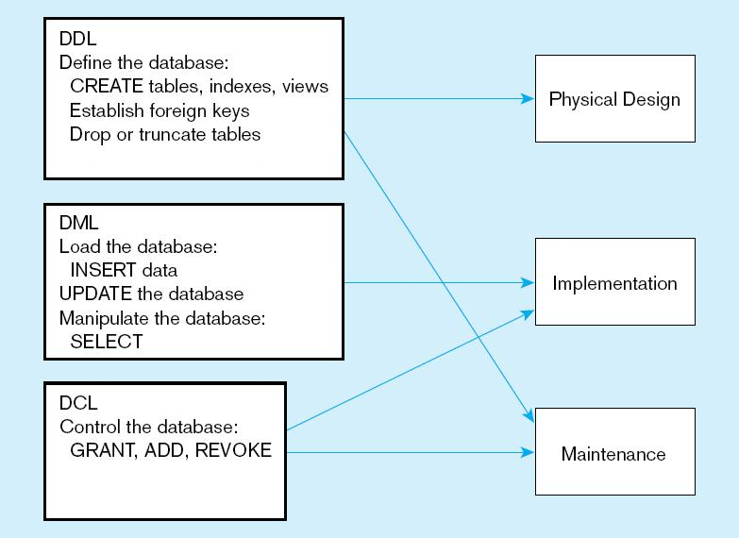
DDL, DML, and DCL
Notes:
Drop table – delete table and its data;
Truncate table – delete the data but keep the table

Slide 36
DDL
DDL: define database
Create table, alter table, drop table
Create indices, views
Establish constraints like foreign keys
Notes:
Metaphor: build a house with many rooms

Slide 37
DML
DML: manage data in database
Insert
Delete
Update
Select (search)
Notes:
Metaphor: put in furniture, change furniture, remove furniture, search for items

Slide 38
DCL
DCL: access control
Add or delete users
Grant and revoke privileges to access database
Notes:
Metaphor: who gets the key to which room

Slide 39
SQL Server and other DBMS vendors
Resource
Microsoft SQL Server website http://msdn.microsoft.com/en-us/sqlserver/default.aspx
The SQL statements in the textbook are based on Oracle. Don’t be surprised if you type them in SQL Server and get error messages.

Slide 40
SQL learning schedule
Week 6: SQL I
create/drop/alter tables (DDL)
Insert/delete/update values
Week 7: SQL II
Conditions in where clause
Aggregation functions
Week 8: SQL III
Join tables
Week 9: SQL IV
Views and transactions
Database administration (DCL)
Week 10: SQL V
Interface design
Client/server connection

Slide 41
Today
Get familiar with SQL Server
Create tables
Drop tables
Insert values
Delete values

Slide 42
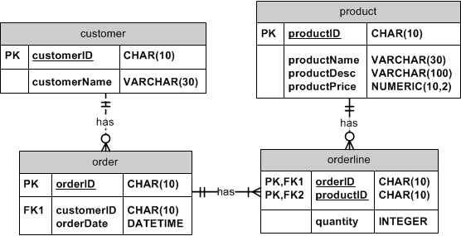
Example: furniture order

Slide 43
The order of creating tables
Referential integrity check
Create entities without FKs first
E.g. Customer and Product tables
They don’t have foreign keys
Then create entities with FKs
Order and then Orderline
Any table that has foreign key referenced to another table cannot be created until the other table has been created

Slide 44
Steps in creating ONE table
Identify data types for attributes
Identify columns that can and cannot be null
Identify columns that must be unique (candidate keys)
Identify primary key–foreign key mates
Determine default values
Identify constraints on columns (domain specifications)
Create the table and associated indexes

Slide 45
Let’s start using SQL Server…

Slide 46
Exercise
Create tables in appropriate order
Exercise
create tables
Insert values

